Slide 1
Software Architecture: Designing the Blueprint for Scalable Systems
Ing. Jonathan Solis Parajeles
ITCR

Slide 2
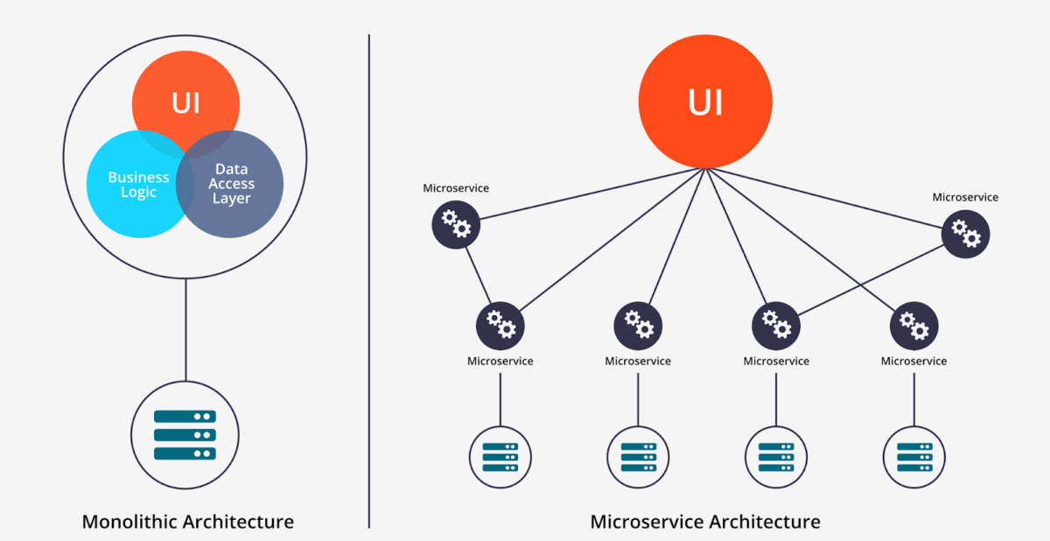
What is Software Architecture?
High‑level structure of a software system — components, their relationships, and guiding principles
Notes:
Like an architect’s blueprint for a building, but for software
Visual:

Slide 3
Why It Matters
Ensures scalability, maintainability, and performance
Guides development teams and aligns stakeholders
Reduces long‑term costs by avoiding ad‑hoc decisions

Slide 4
Core Architectural Styles
Layered (n‑tier) – UI, business logic, data
Microservices – Independent, loosely coupled services
Event‑Driven – Components react to events asynchronously
Client‑Server – Central server with multiple clients

Slide 5
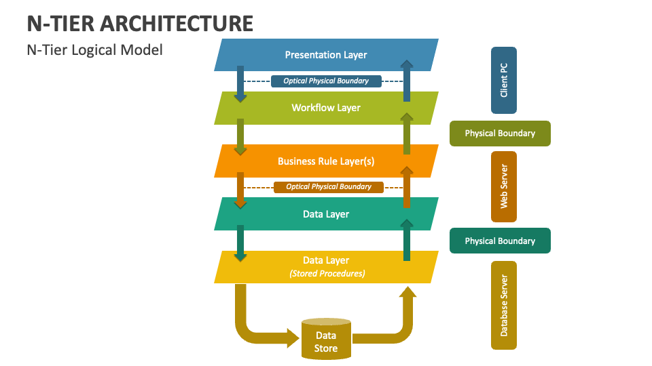
Layered (n-tier)

Slide 6
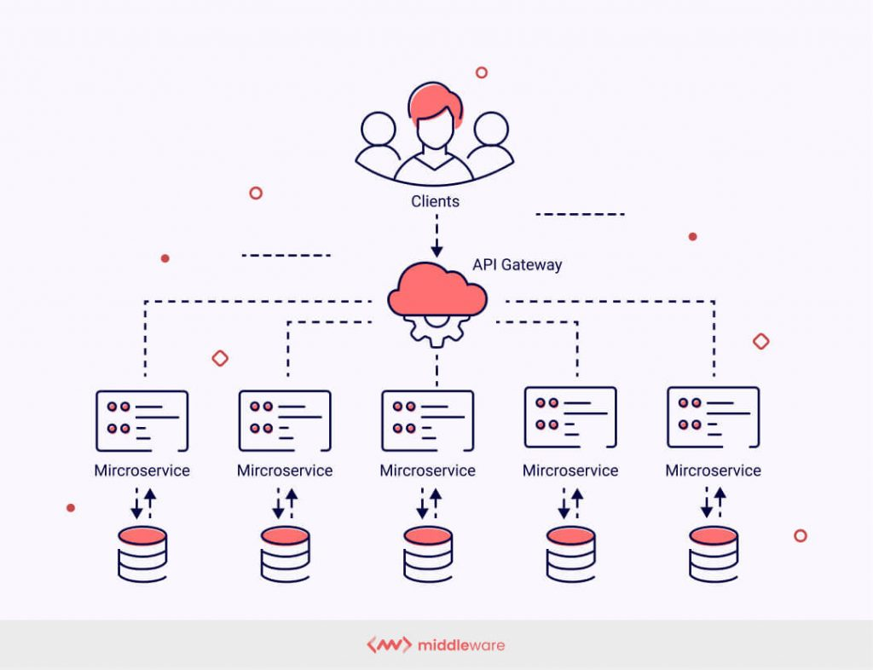
Microservices

Slide 7
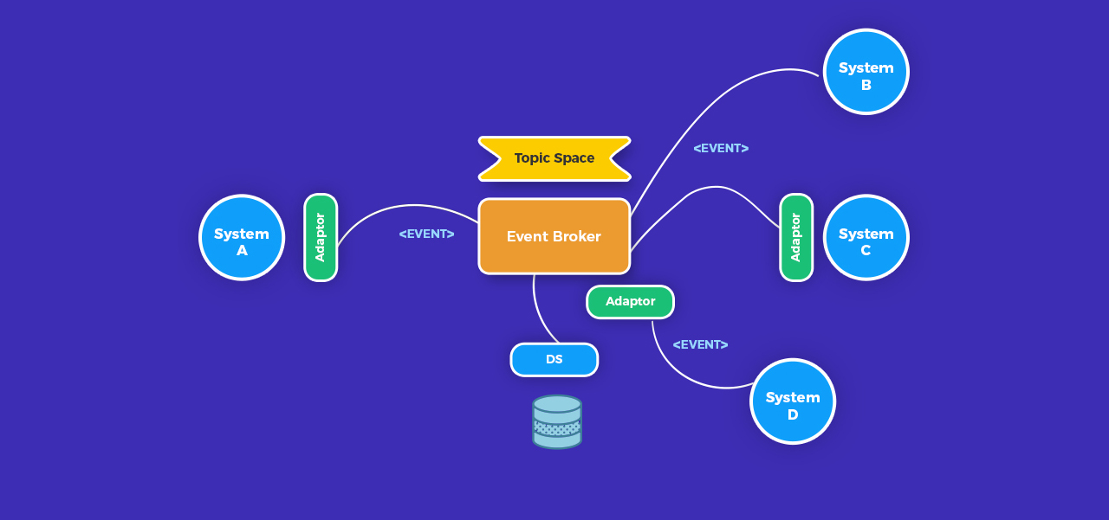
Event‑Driven
Notes:
Kafka

Slide 8
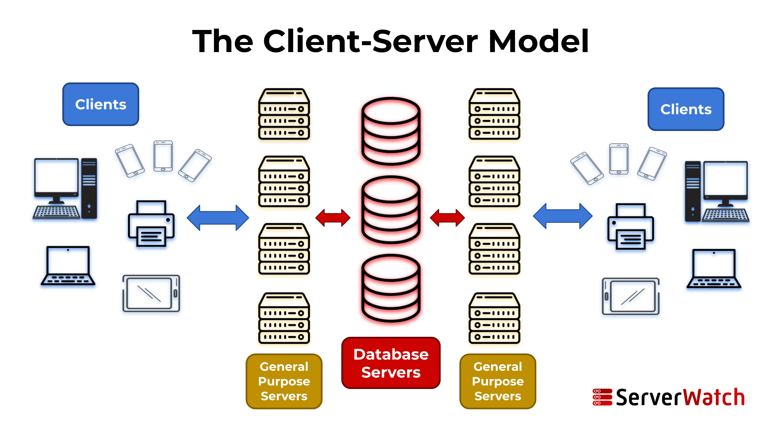
Client‑Server

Slide 9
Key Components & Connectors
Components: Modules, services, databases, APIs
Connectors: Protocols, message queues, service buses

Slide 10
Quality Attributes
Performance – Response time, throughput
Security – Authentication, authorization, encryption
Scalability – Horizontal/vertical scaling
Maintainability – Ease of updates and debugging

Slide 11
Tools & Frameworks
UML, ArchiMate, PlantUML for diagrams
Cloud architecture tools (AWS, Azure, GCP)
CI/CD pipelines for architecture validation

Slide 12
For The Road
Go to the Microsoft Azure Portal.
Login using your TEC account.
Validate that you have enough credits.
Play around with the service.

Slide 13
Best Practices Reading
Best Practices in Software Architecture for Scalable, Secure, and Maintainable Systems - DEV Community
Software Architecture Design Best Practices You Should Know

